Slide 1

Generating Cyber Forensics Data
Sri Varsha Adavath
Lalith Mohan Midde

Slide 2

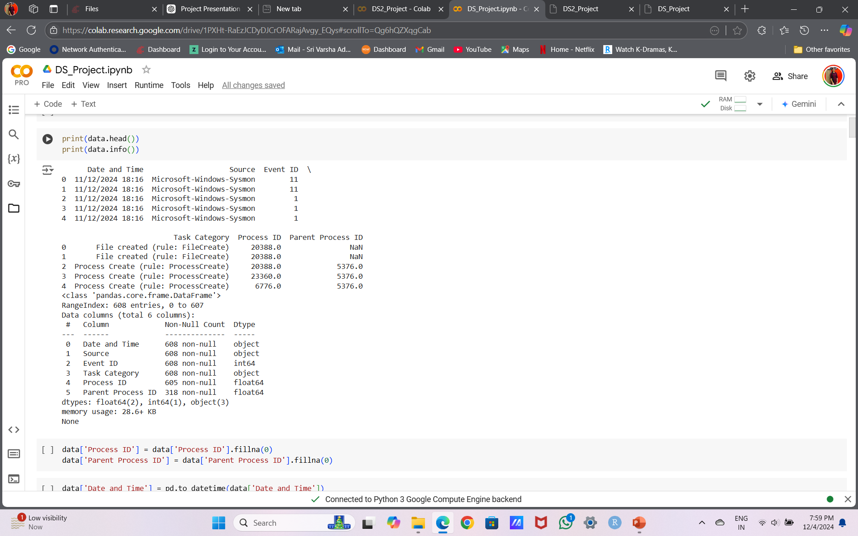
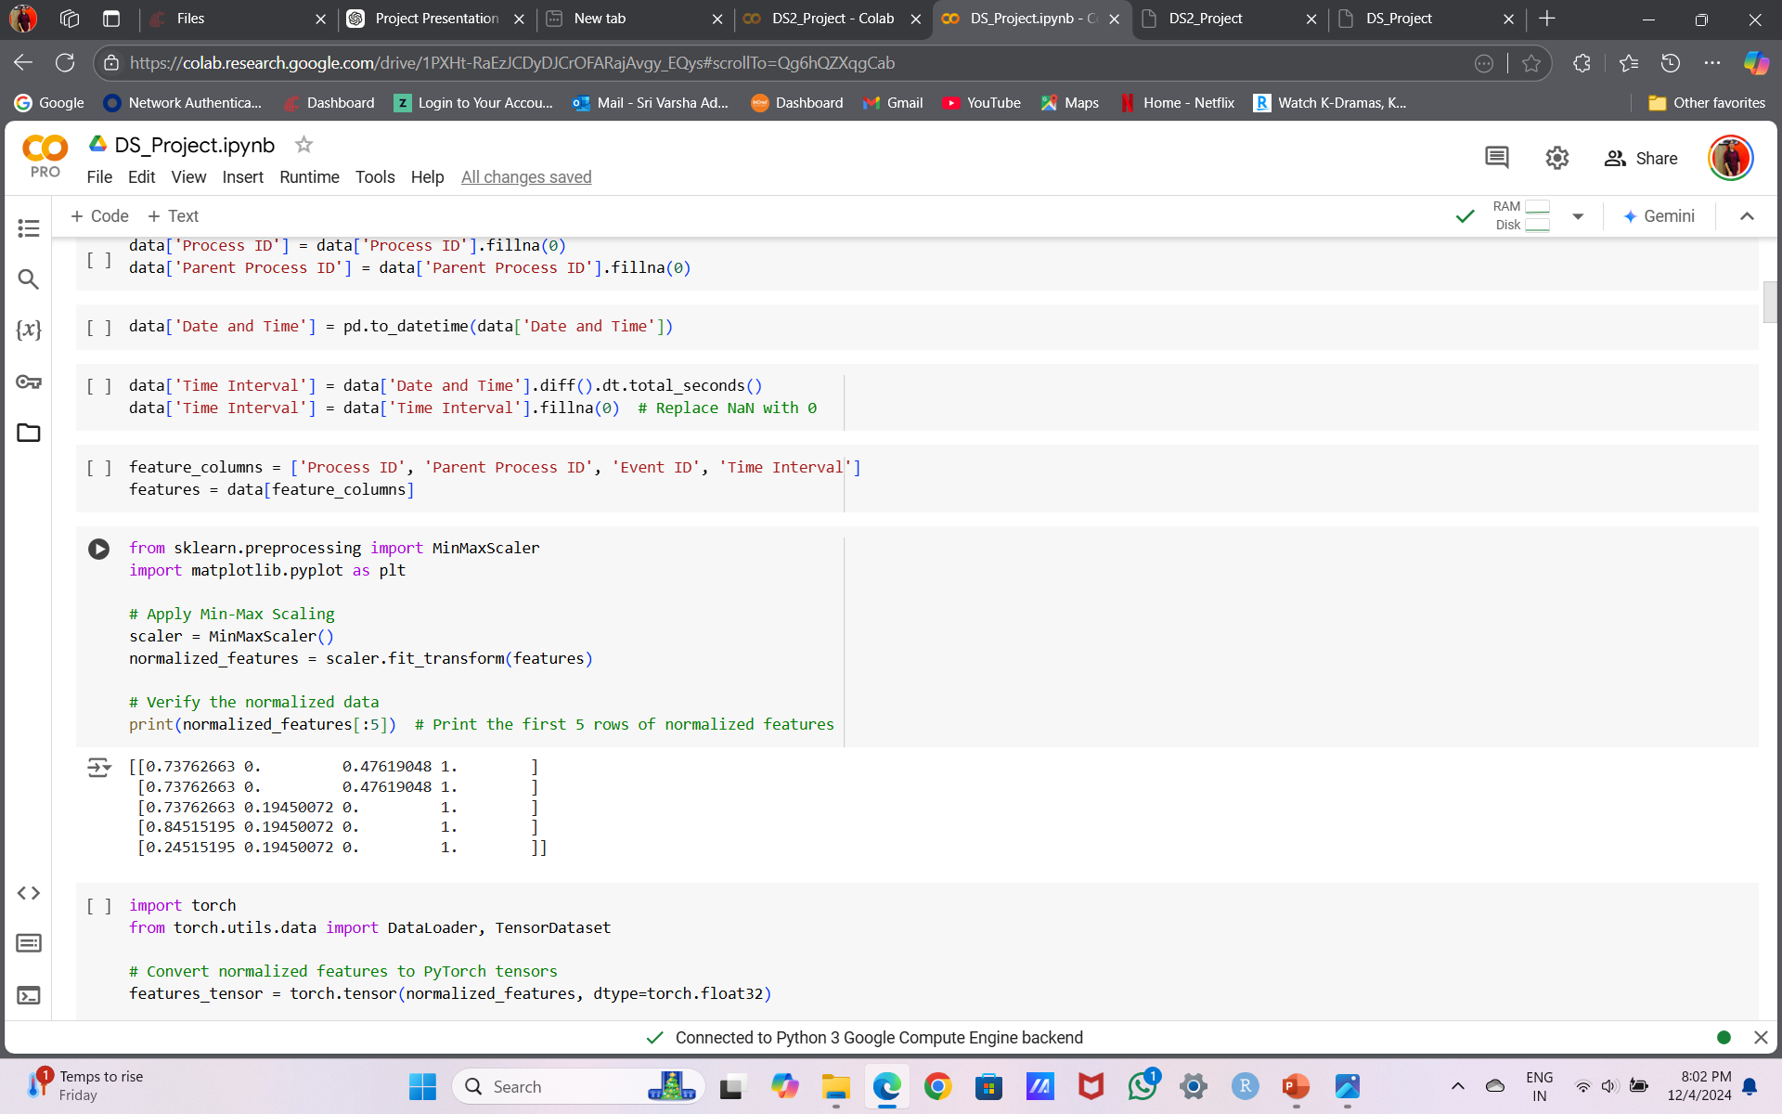
Introduction
Problem Statement: The challenge of obtaining diverse and realistic datasets for testing cyber-forensics tools.
Objective: Develop a generative model (VAE/GAN) to synthesize realistic Sysmon data logs for process creation events.

Slide 3
Methodology
Collect
Collect real Sysmon data.
Engineer
Engineer features (e.g., timestamps, process hierarchies).
Train
Train a generative model to create synthetic datasets.
Key
Key Features: Focus on diversity in generated data, including benign and anomalous events.

Slide 4
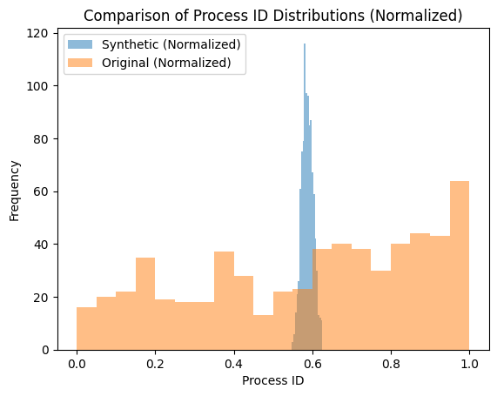
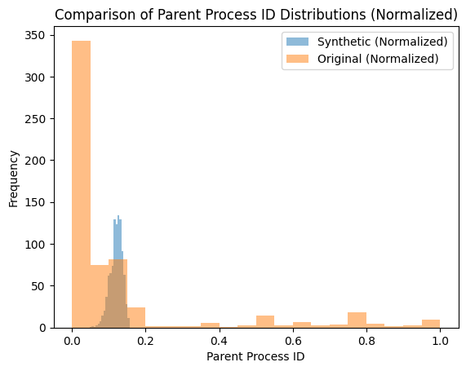

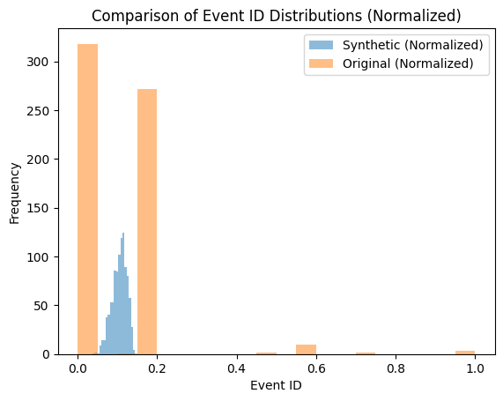
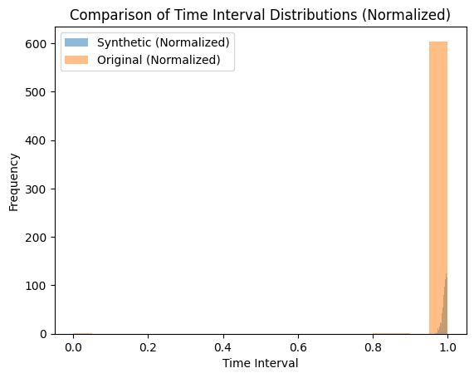
Progress & Results
Progress:
Completed data collection and initial feature engineering.
Researched and selected VAE models based on stability and applicability.

Slide 5
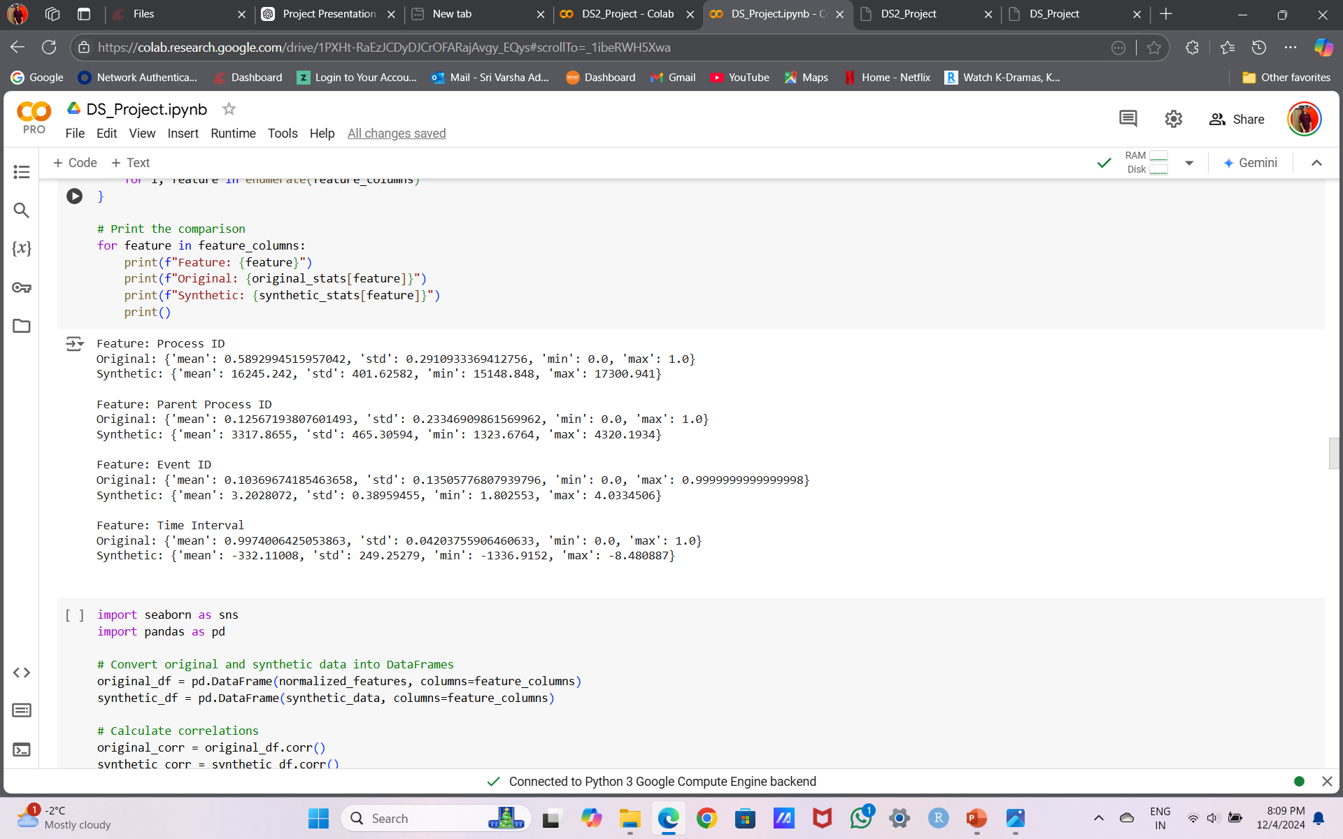
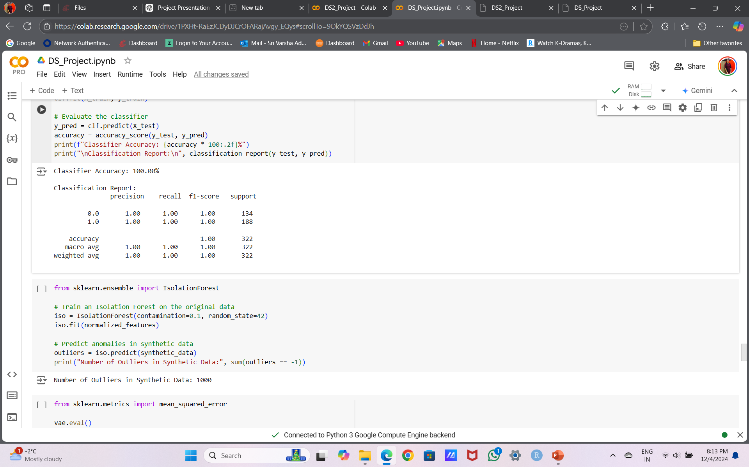
Statistics for Original and Synthetic Data
Anomaly Detection Accuracy

Slide 6

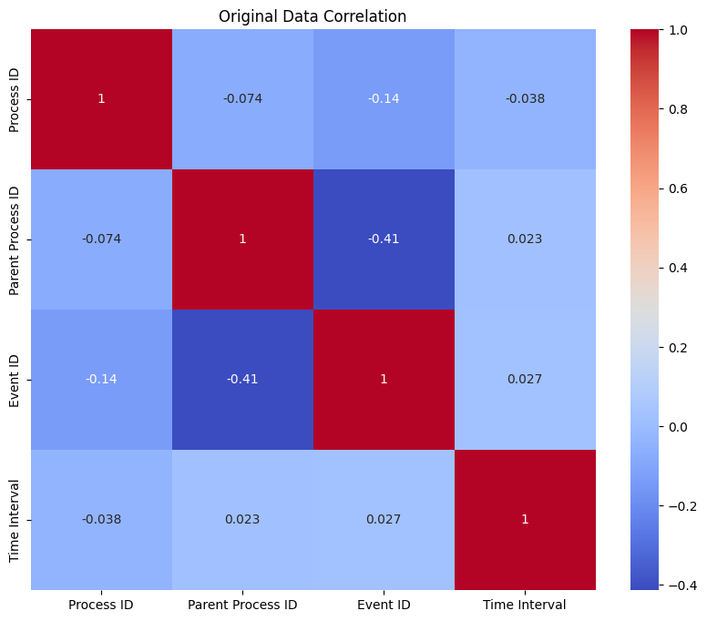
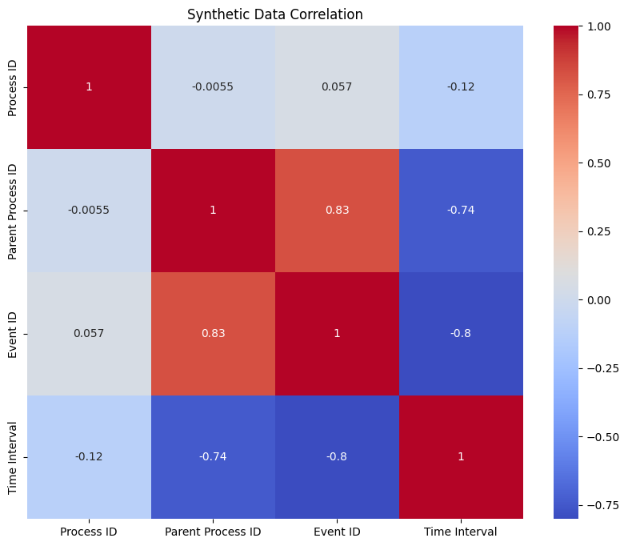

Slide 7
Future Work & Conclusion
Future Work:
Refine feature engineering and train the generative model.
Validate synthetic data against real-world benchmarks.
Conclusion:
Our approach creates scalable, realistic datasets, enabling innovation in cybersecurity tools without compromising privacy.

Slide 8
Thank You

